Slide 1
NYC MTA Subway EDA
Notes:
Prepared by Abdullah & Omran

Slide 2
CONTENTS
01
Introduction
04
Analysis
02
Problem Statement
05
Results
03
Approach and Methodology

Slide 3
01
Introduction
Bull Ψ
Data Analysis and Advertisement Agency.
Our Goal.
The aim of this project
Notes:
We help companies succesfully launch brands and products, or develop their existing brands and products.
is to provide our clients with the best possible location for their products on our billboards across NYC MTA subway, based on MTA data and NYC demographic data.
is to successfully place the right advertisement on the right billboard based on our clients brands and targeted demographic.

Slide 4
02
Problem Statement
Our agency was hired by multiple clients to promote their products to gain higher exposure levels which would result in increased sales.

Slide 5
03
Approach & Methodology
NYC MTA subway data of 2021
NYC demographic.
Data Cleaning
Performed EDA On:
NYC MTA data.
NYC Demographic data 1-square Mile block around MTA Subway Stations.
Based on our EDA we located the top 5 busiest stations.

Slide 6
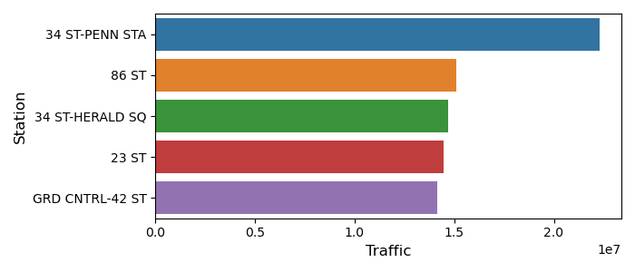
Analysis

Slide 7
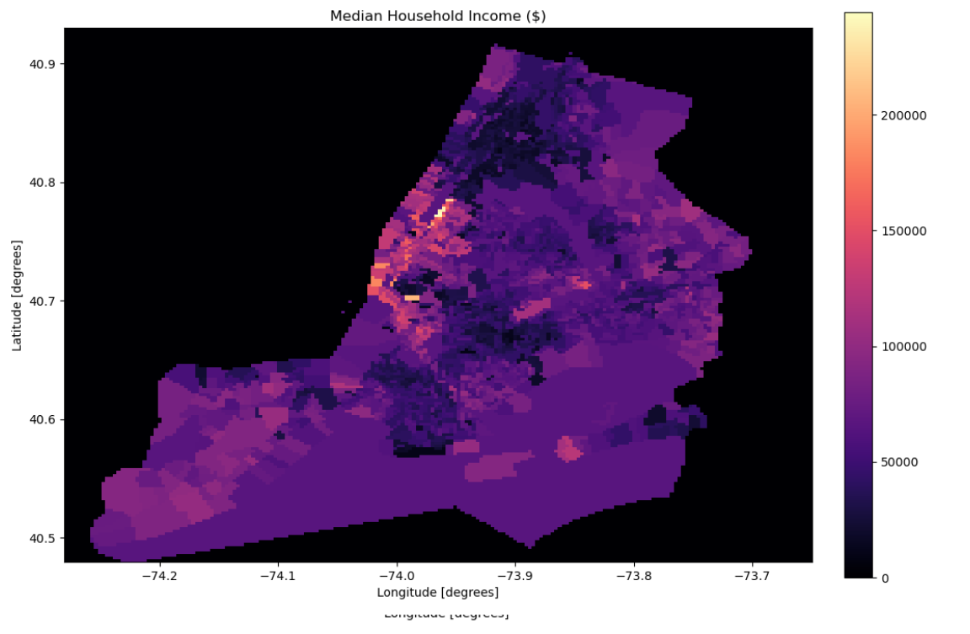
Analysis

Slide 8
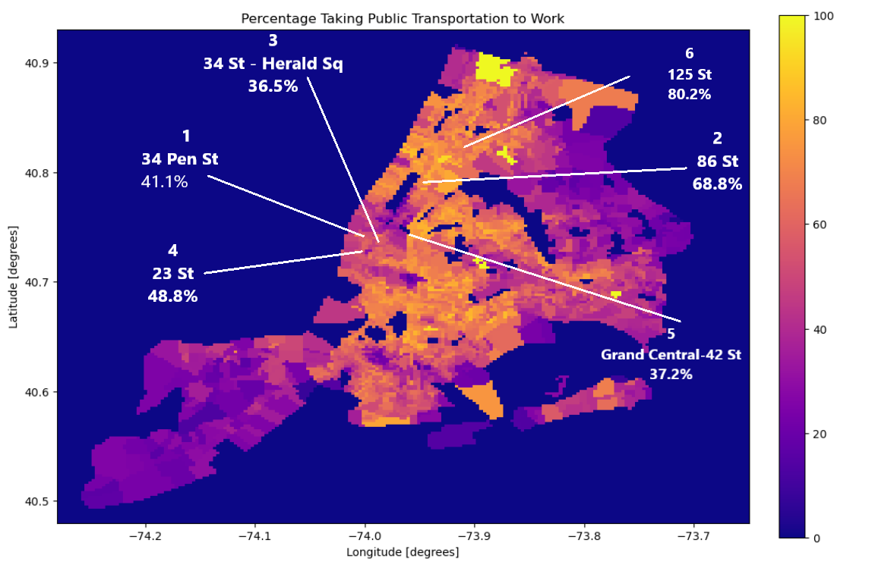
Analysis

Slide 9
05
Results
34 Penn St fits our Tech Client (Apple)
86 St fits our Retail Store Client(Ikea)
34 St Herald Sq fits our banking client(US Bank)
23 St fits our Make up client(Sephora)
Grand Central 42 St fits our clothing client (H & M)
125 St fis our food chain client (KFC)
Notes:
1- 34 Penn Station has a high median income (Rich) $160k with 60% of the population are Males (High end tech fits) plus many people from middle class are going through the same station who might be tempted to join in, fits the targeted demographic of our tech client
2- 86 St Station has an above average median income(Upper Middle class) $120k and it has high traffic(56%) ,fits the targeted demographic of our Retail store client
3- 34 St Herald Sq has an average median income (middle class) $103k which fits the targeted demographic of our banking client
4- 23 St Station has an above average median income(Upper Middle class) $136k and it has high traffic(60%) ,which fits the targeted demographic of our make up client
5- Grand Central 42 St Station has an a above average median income(Upper Middle class) $122k, which fits the targeted demographic of our clothing client
6- 125 St has below average median income (Poverty Line) $19k, which fits the targeted demographic of our food chain client

Slide 10
THANK YOU

